Slide 1
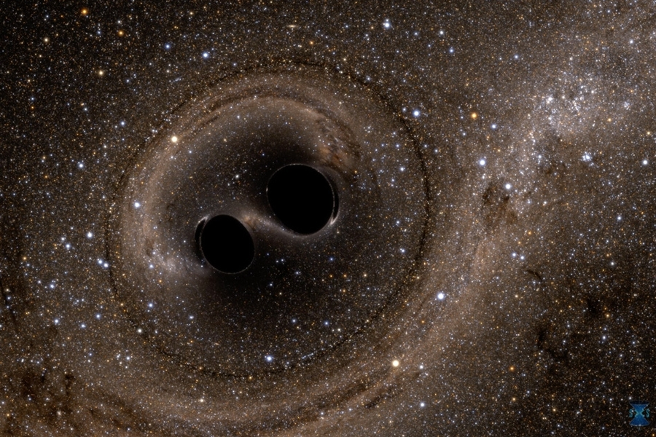

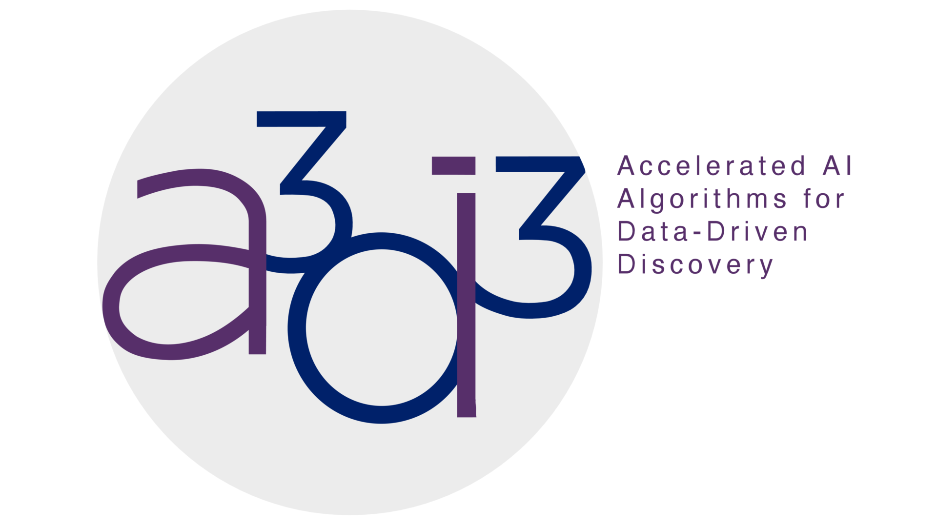
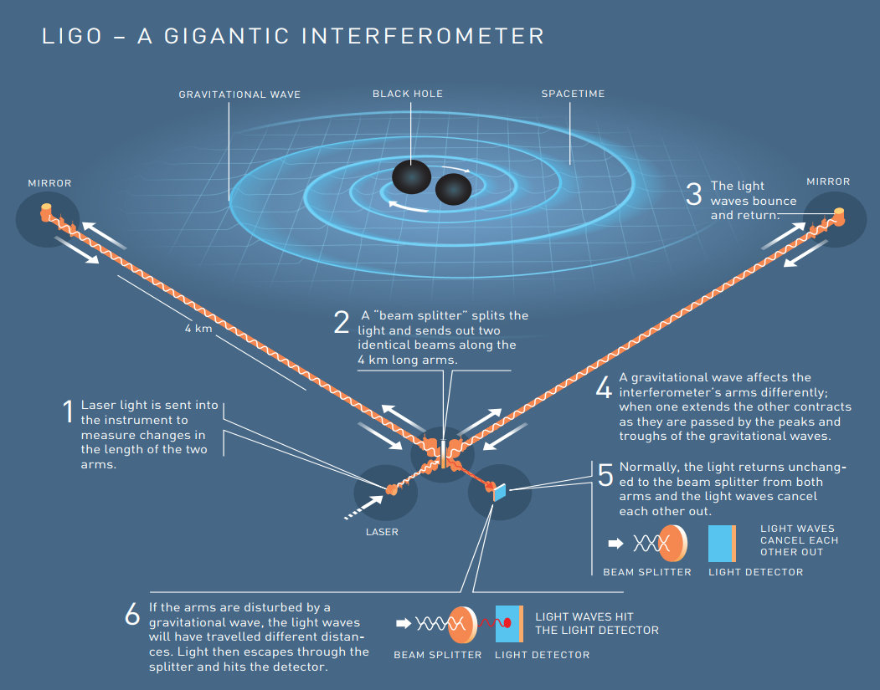
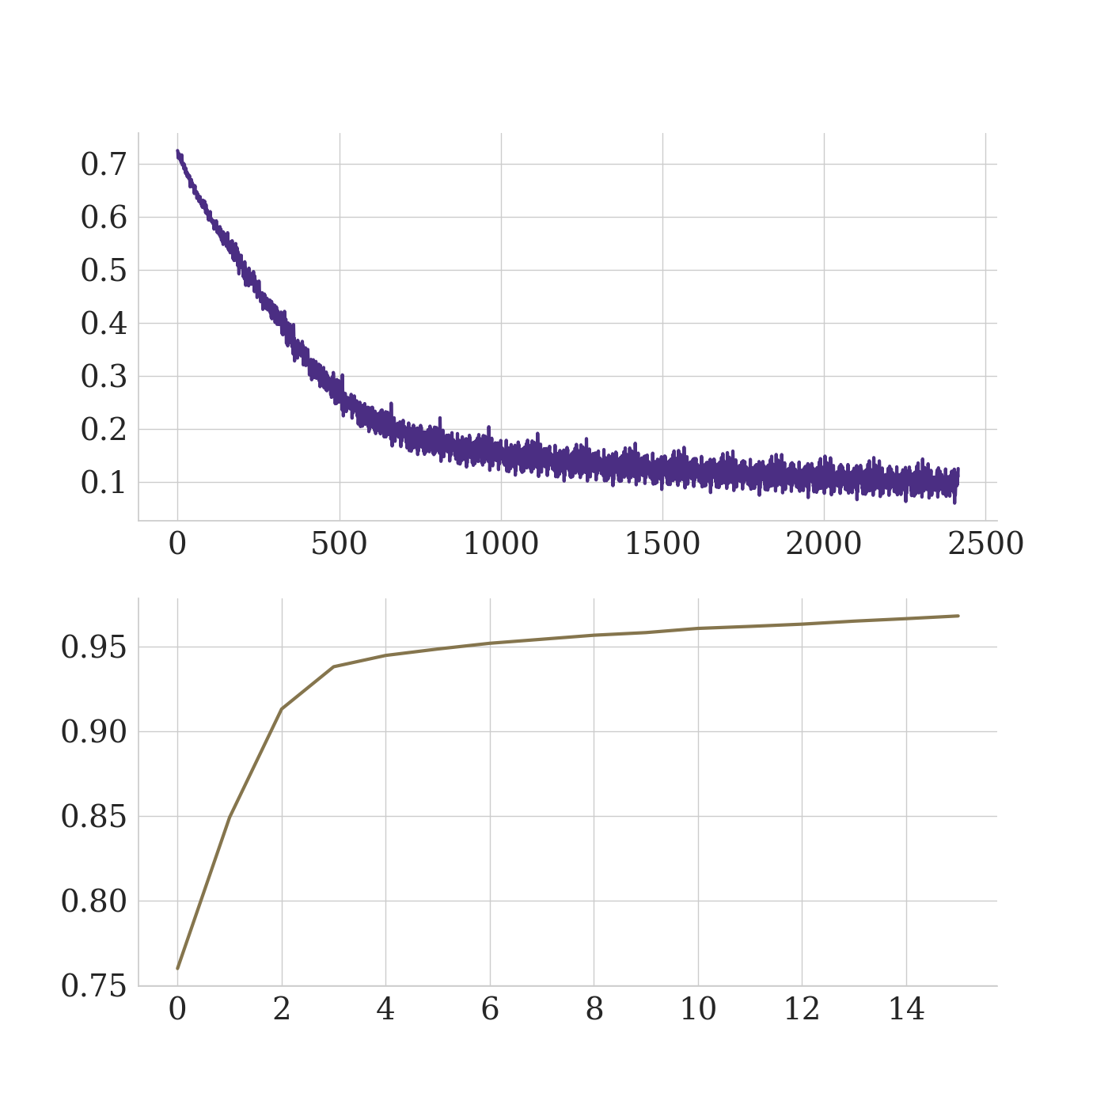
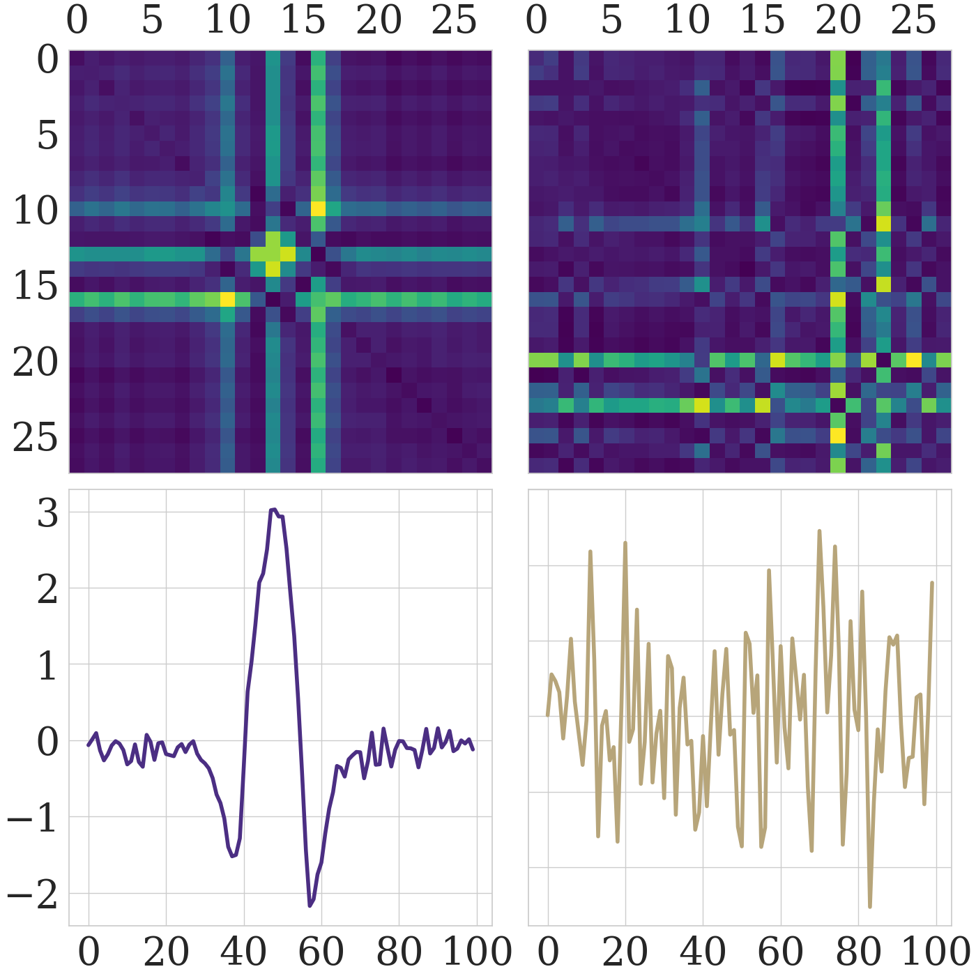
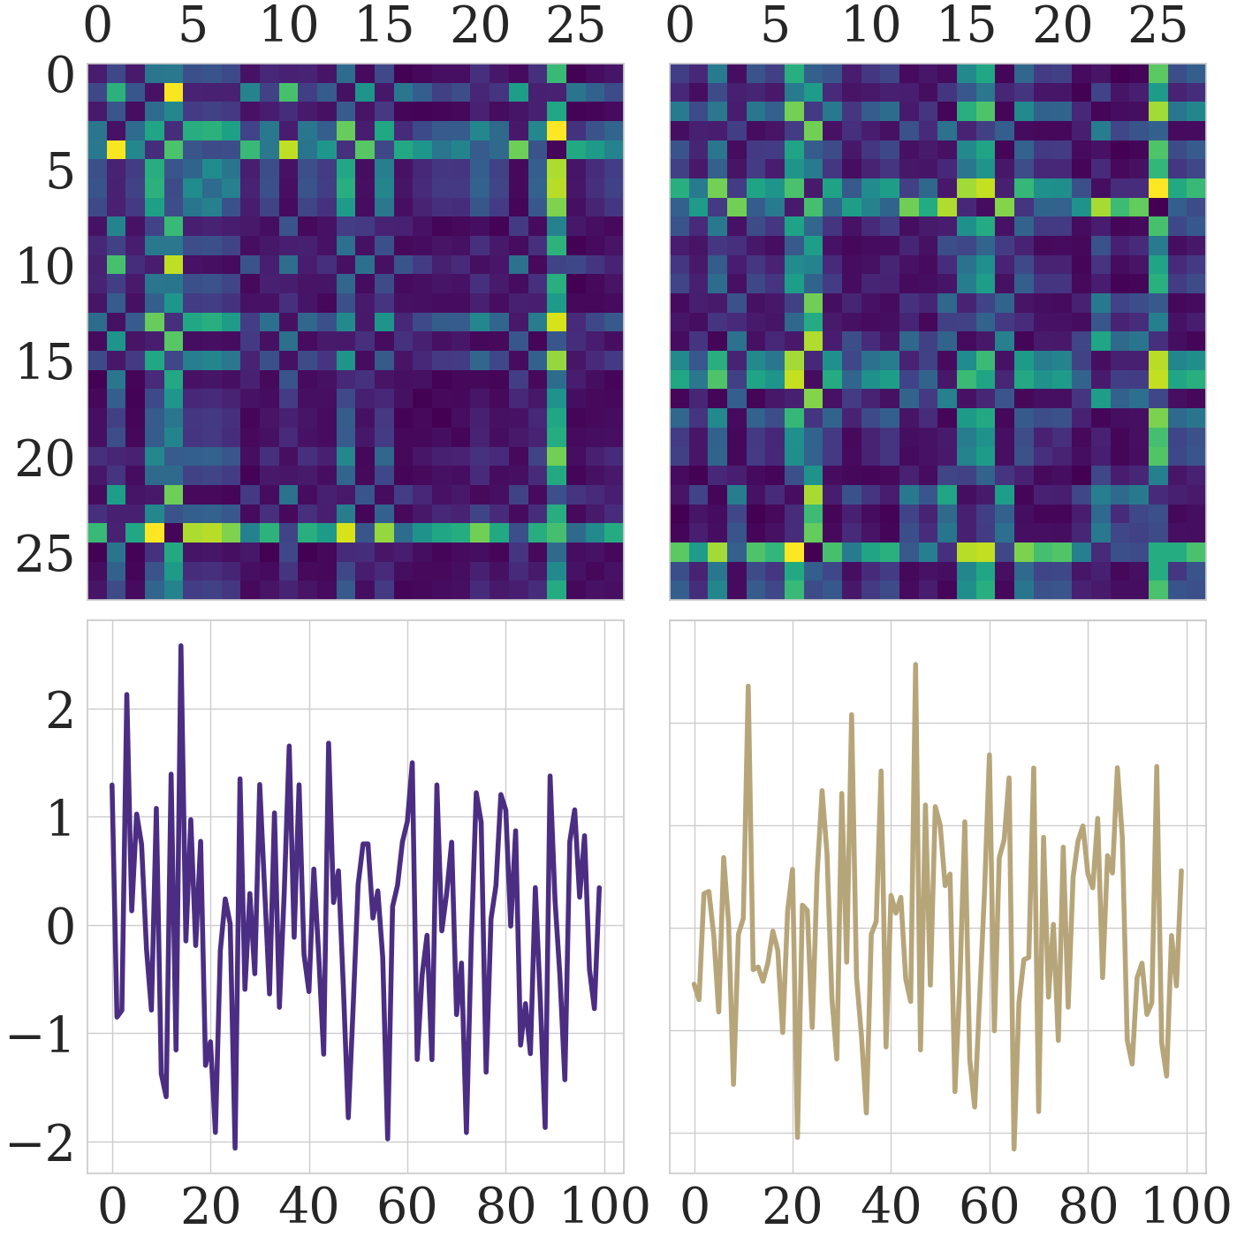
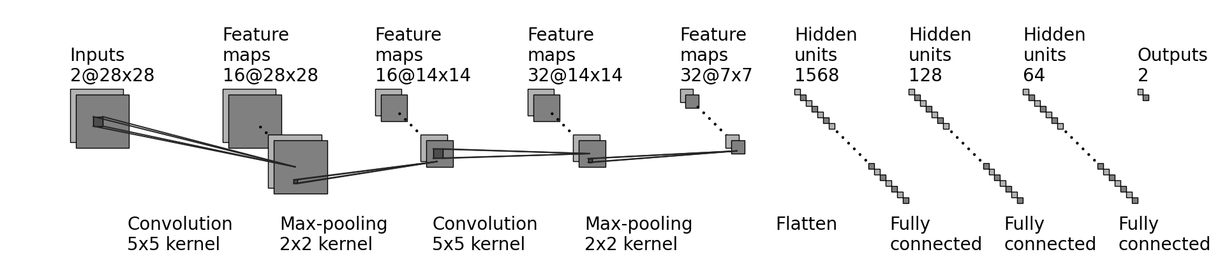
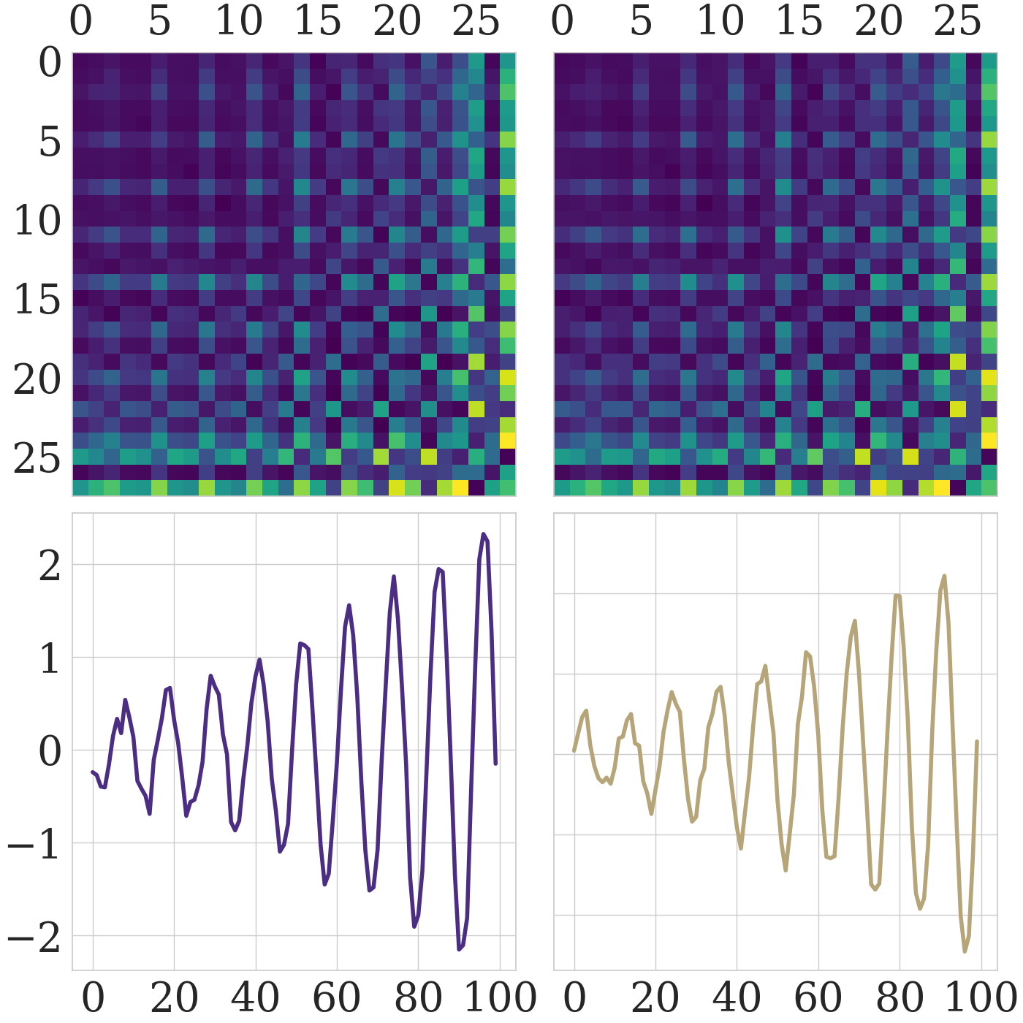
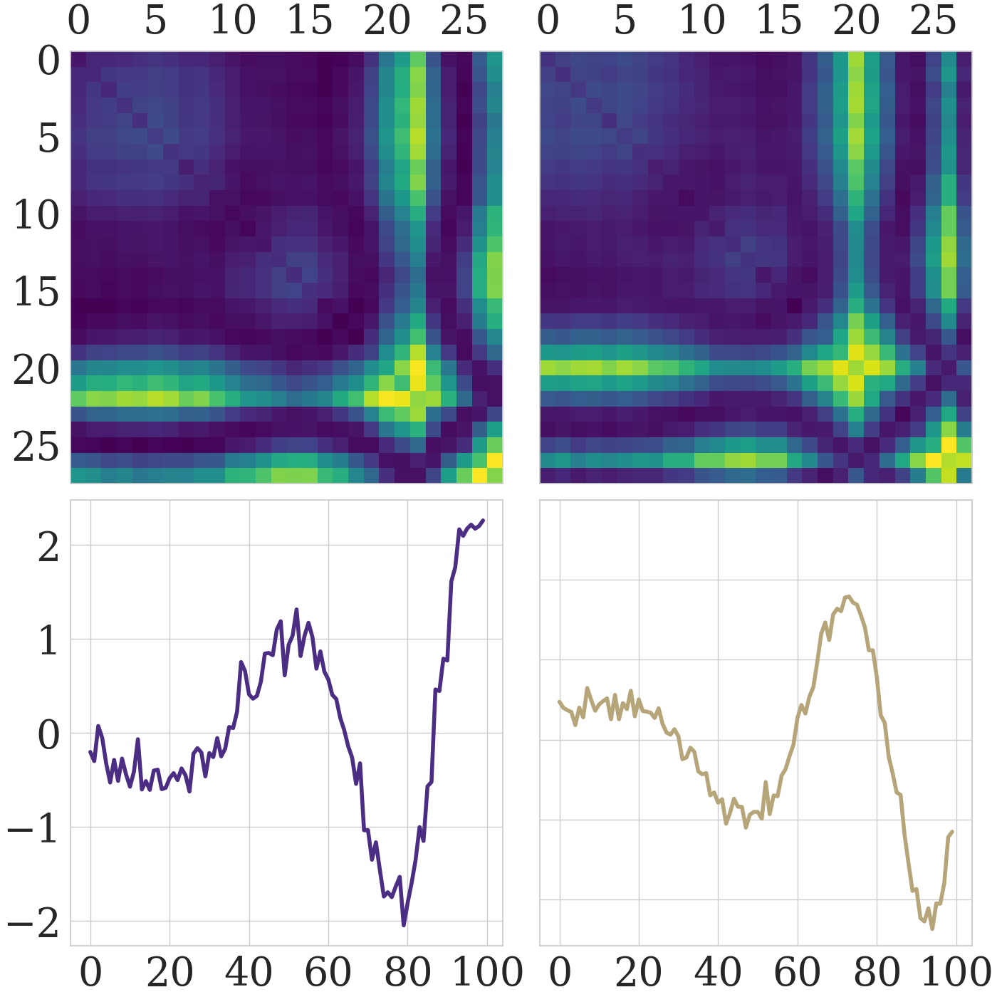
UNRAVELING GRAVITATIONAL RIPPLES: NEURAL NETWORK CLASSIFICATION
Daniel Fredin¹, Cole Welch¹
¹Department of Physics, University of Washington
Artist’s rendition of binary black hole merger.
Physics 417 Symposium @ eScience Institute
June 1, 2023
INTRODUCTION
Quick Facts About Our CNN
> ~ 97% testing accuracy
> Data split of 70% training, 15% validation, and 15% testing
> Dataset contains a total of 146045 gravitational wave time series data points
> Applied Gramian Angular Summation Field (GASF) algorithms to encode gravitational wave data as 2D images for classification
> Neural network contains 2 convolutional / max-pooling layers followed by 3 fully connected layers and an output
> Utilized a cross-entropy loss function with an Adam optimizer
> Utilized batch normalization and ReLU activation functions along with L2 Regularization
RESULTS
Dataset source: Glitch dataset originates from the Laser Interferometer Gravitational-Wave Observatory (LIGO) in Hanford, WA, and Livingston, LA.
LIGO observatory: Designed to identify and understand the sources of gravitational waves using light and space characteristics.
Dataset categories: Consists of four distinct data categories - Glitch, Background, Sine-Gaussian (SG), and Binary Black Hole (BBH).
Objective: Develop a binary classifier to identify signals as either Glitch/Background or Sine-Gaussian/Binary Black Hole.
Model performance: After 16 epochs and over 2400 iterations, training loss reached 0.1, while the validation accuracy approached 96%.
Testing accuracy: CNN model demonstrated an exceptional accuracy of 97% when evaluated on the testing dataset.
Comparison with literature: Similar CNN architectures in the literature achieved higher accuracies, such as 99% (Fernandes et al., 2018) and 98.8% (George D. et al., 2023).
Dataset differences: Our dataset consisted of separate time series for gravitational wave signal data and noise data, while other works had to apply more complex noise filtering methods.
Image conversion: Gramian Angular Summation Fields were effective for image conversion in our case, while others found Fourier transforms more suitable for handling complex noise and background through frequency domain filtering.
DATA ANALYSIS
Training Loss and Validation Accuracy
Scaling: Utilized the StandardScaler function to ensure data was normalized before conversion to GASF images.
Model output: Probability predictions of images for background or signal compared to ground truth targets with Softmax function.
Testing and accuracy: Tested trained model against a separate testing dataset, achieved an overall accuracy of 97%.
Misclassification patterns: Model tends to misclassify when detectors have conflicting data.
Example misclassification: In the sample of glitch data below, the model misclassified the GASF image as a signal, despite the Hanford signal being glitch and Livingston signal being background noise.
Possible flaws: Confusion may arise from contradictory signals between detectors or flaws in observatory data capture.
Training Loss
Fundamental configuration of the LIGO interferometer.
METHODOLOGY
Iterations
Problem: Implementing a binary classifier using PyTorch for time series data.
Image Conversion: Convert time series data to 2D images using Gramian Angular Summation Fields (GASFs) with the pyts library.
Image size: GASF images are 28x28 pixels for a balance between performance and accuracy.
Data splitting: Split data into training (70%, 102227 images), testing (15%, 21910 images), and validation (15%, 21908 images) sets.
CNN architecture:
Convolution layers: Two convolution layers; layer one having 2 input channels, 16 output channels, and layer two having 16 input channels, 32 output channels, both with kernel size of 5, stride of 1, and padding of 2.
Max pooling layers: Applied after each convolution layer with kernel size of 2, stride of 2, and padding of 0.
Fully connected layers: Three subsequent linear layers with dimensions 1568x128, 128x64, and 64x2, respectively.
Training: Trained for 16 epochs, learning rate of 5e-6, batch size of 677, L2 regularization with coefficient 0.001.
Loss function and optimizer: Cross-entropy loss function and Adam optimizer.
Validation Accuracy
Epochs
Glitch
Background
Top: The training loss of the CNN plotted against the number of iterations.
Bottom: The validation accuracy of the CNN plotted against the number of elapsed epochs.
Hanford
Livingston
Hanford
Livingston
CONCLUSION
Pixels
Pixels
Pixels
Pixels
Objective: Analyzing the potential of CNNs for classifying gravitational waves strain data as background noise/glitches or transient sine-gaussian/binary black hole merger signals.
Approach: Utilized a streamlined variation of a CNN based upon versions existing in literature.
Performance: Exceeded the anticipated 85% accuracy by attaining an impressive testing accuracy of 97%.
Comparison: Achieved accuracy slightly below more complex CNNs documented in literature.
Further exploration: Examining the efficacy of the GASF technique in transforming time series data into images and feeding them through a basic CNN, by using a dataset of more contaminated gravitational waves for analysis.
Pixels
Pixels
Strain
Strain
Time (s)
Time (s)
Time (s)
Time (s)
Sine-Gaussian
Binary Black Hole
Hanford
Livingston
Hanford
Livingston
Pixels
Pixels
Pixels
Pixels
REFERENCES
Basic structure of our convolutional neural network (CNN).
Pixels
Pixels
Gramian Angular Summation Fields
[1] Z. Wang and T. Oates. Encoding Time Series as Images for Visual Inspection and Classification Using Tiled Convolutional Neural Networks. In The Twenty-Ninth AAAI Conference on Artificial Intelligence. (AAAI), January 2015.
[2] T. S. Fernandes, et al. Convolutional Neural Networks for the classification of glitches in gravitational-wave data streams, arXiv:2303.13917v1 [gr-qc], March 2023.
[3] D. George, H. Shen, and E. A. Heurta. Glitch Classification and Clustering for LIGO with Deep Transfer Learning. Phys Rev. D, 97:101501, May 2018.
Definition: Method for visualizing time series data in a two-dimensional image format.
Conversion: Converts time series into a symmetric matrix which represents the pairwise angles between points in the time series.
Application: Provides visual representation of complex temporal patterns which is useful for tasks like classification of time series data.
Strain
Strain
Time (s)
Time (s)
Time (s)
Time (s)
An example of the four signal categories derived from the time series data, along with their corresponding GASF images captured by both the Hanford and Livingston detectors.

